Slide 1

Feature Transformation in DL Discretization & Binarization
Yijie Guo
Yu Chen

Slide 2
Information Bottleneck

Slide 3
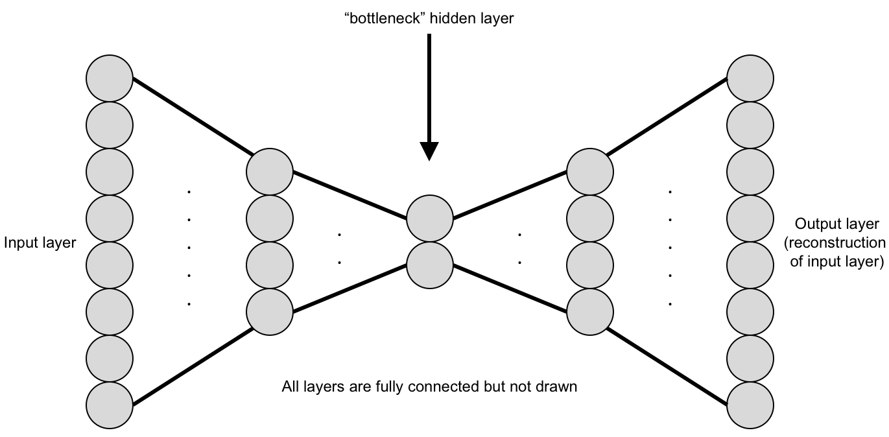
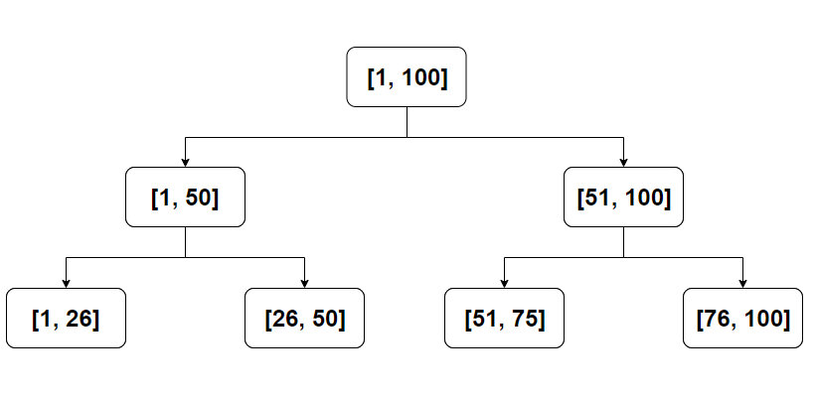
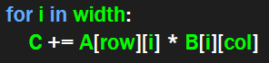
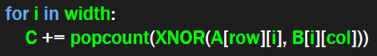
Information Bottleneck
Quantization
[1] Compressing the floating point input/output values in DNN to a fixed point representation, like 8-bit or 16-bit integers.
[2] Memory and Computation Reduction
Binary Neural Network
Inputs, outputs and weights are all binary values. By binary here, we mean Bipolar Binary, i.e. +1 & -1 values.

